Slide 1
Results Presentation 1Q25
Date: 05/15/2025
12:00 PM (US ET)

Slide 2
Instructions
This conference will be in Portuguese, with simultaneous translation into English.
Changing the Language: to access simultaneous translation, click on the “Interpretation” button at the bottom right of the screen and choose the “English” language.
To ask questions: click on the “Q&A” icon and write your question to join the queue. We recommend that all questions be asked at once.

Slide 3
Disclaimer
Bento Gonçalves, Rio Grande do Sul, May 15, 2025. Unicasa Indústria de Móveis S.A. (B3: UCAS3, Bloomberg: UCAS3:BZ, Reuters: UCAS3), one of the leading companies in Brazil’s custom-made furniture industry and the only Brazilian publicly held company in the sector, announces today its results for the first quarter of 2025. Except where stated otherwise, all variations and comparisons are in relation to the same period of the previous year. The following financial and operating information, except where stated otherwise, is presented with consolidated data (including Unicasa Comércio de Móveis Ltda. and Unicasa North America, LLC), in thousands of Brazilian reais and in accordance with the International Financial Reporting Standards (IFRS).
The forward-looking statements in this document related to the business prospects, projections of operating and financial results and growth prospects of Unicasa are merely estimates and as such are based exclusively on the expectations of the Company’s Management for the future of the business, and therefore are subject to known and unknown risks and uncertainties that could result in them not materializing or differing materially from expectations.

Slide 4
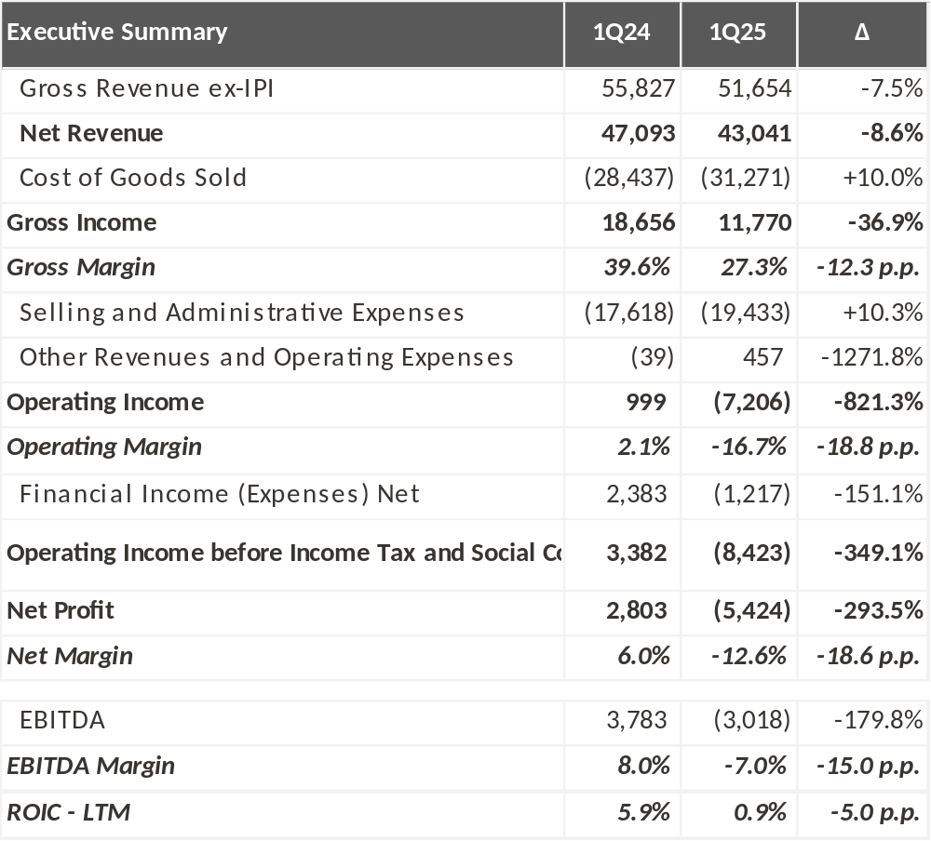
Executive Summary
Gross margin of 27.3%
Net Margin
-12.6%
EBITDA Margin of
-7.0%

Slide 5
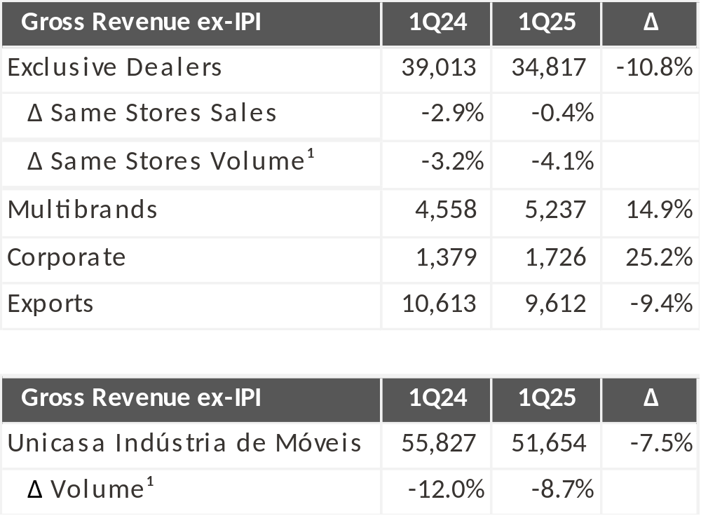
Sales Performance
¹ Obtained through the deflated calculation of revenue due to price increases passed on to retailers and disregarding any commercial discounts granted.

Slide 6
Executive Summary
Gross margin of 27.3%
Net Margin
-12.6%
EBITDA Margin of
-7.0%

Slide 7
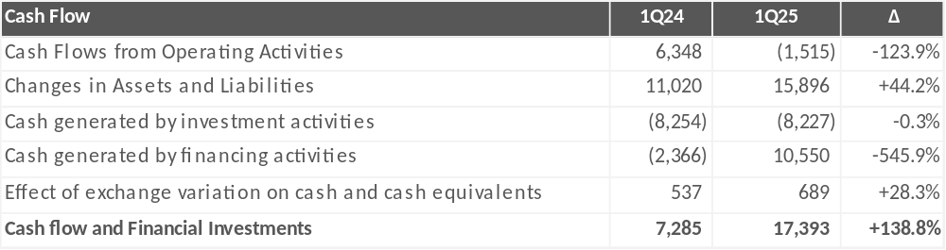
Cash

Slide 8
Questions
To ask questions: click on the “Q&A” icon and write your question to join the queue. We recommend that all questions be asked at once.

Slide 9
Gustavo Dall Onder
CEO
Alexandre Narvaes Figueira
CCO
Luciano André Merigo
COO
Guilherme Possebon de Oliveira
CFO, DRI
Investor Relations
Felipe De Gasperin
Andressa Grasseli
+55 (54) 3455-4425
dri@unicasamoveis.com.br
http://unicasamoveis.com.br/ri

